Slide 1
Data book
BL series of ceiling AP
BL 220Q
Document version number: V1.0
Copyright©2020 Shuotian Information Technology Co., Ltd. All rights reserved

Slide 2
Directory
1. Product characteristics·····························································4
2. Packing list·················································································5
3. Application scenarios································································6
4. Hardware specifications····························································8
5. Radio frequency parameters····················································8
6. Software features····································································10
7. Physical properties··································································11
8. Contact information································································11
2
www.sskycn.com

Slide 3
BL220Q - Wireless access point
BL220Q is an industrial-grade indoor ceiling AP, mainly used for Wi-Fi coverage in hotels, cafes, homes and other places. This AP using the suction a top 2T2R 2.4 G wireless MIMO technology, the bandwidth of up to 300 Mbps, supports up to 57 users or 32 video users use wireless Internet at the same time, anti-interference, effectively prevent outside interference, wireless support 80 ~ 100 m Ethernet cable power supply, reduces the installation costs, also make the installation more convenient to use, especially this product can be used where there is no power supply output, improved the traditional network infrastructure, in order to unified management. In addition, the BL220Q uses a new ceiling design, well integrated with modern hotel interior decor, installed in the optimal ceiling position, can extend the wireless signal to the adjacent connected several rooms, network applications and landscaping integration.
01
Product characteristics
3
www.sskycn.com

Slide 4
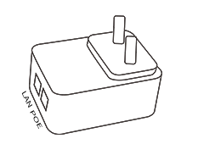
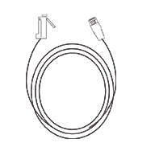
02
Packing list
BL220 Bridge×1
Power adapter×1（24V0.5A)
Cable×1
（1 meter）
Product specification×1
4
www.sskycn.com

Slide 5
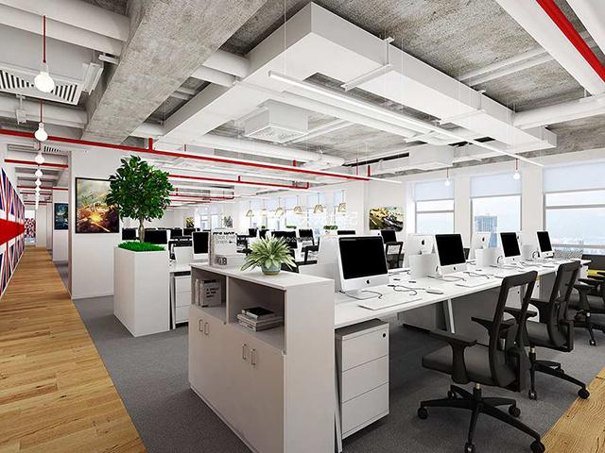
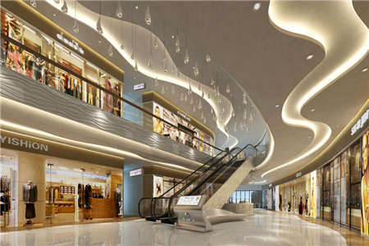
03
Application scenarios
1. Office, classroom and other indoor places
2. Shopping malls, supermarkets and other places
5
www.sskycn.com

Slide 6
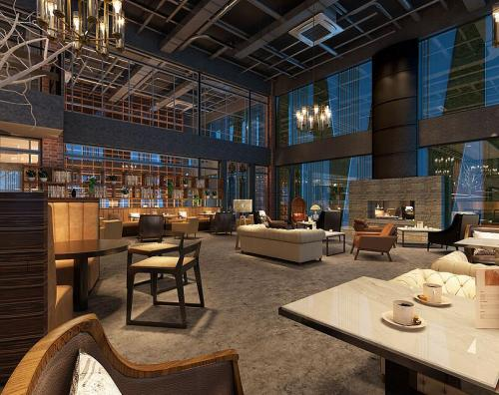
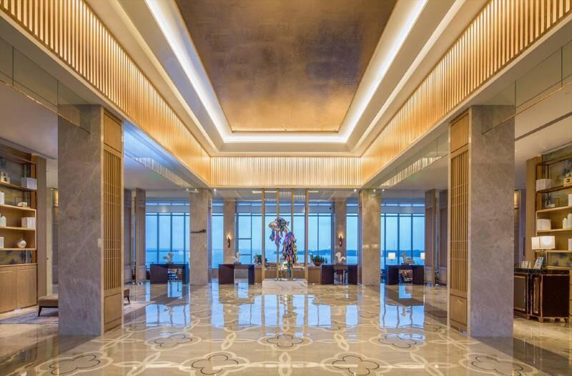
3 . Restaurants, cafes and other places
4. Hotel and other places
6
www.sskycn.com

Slide 7
04
Hardware specifications
Hardware specifications
Chipset | AR9531 300Mbps wireless AP professional chipset
Wireless teconology | 802.11N, 2T2R 300M MIMO Teconology
Memory | 64MB DDR RAM (Can be extended to 64MB)
Flash | 16MB(Can be extended to 8MB)
Device interface | 1* 10/100 Mbps Wan 1*10/100 Mbps Lan
 | One reset button, restore the default Settings used
 | One DC power interface supports 12V local power supply
Antenna | 2.4G MIMO omnidirectional high gain 5DBI built-in antenna
Size | 330mm*230mm*55mm
Weight | 0.65kg
Power consumption | 500mW
Power Supply | 12V(POE 48V)/1A;110V/220V
05
Radio frequency parameters
Radio frequency parameters
Modulation mode | OFDM = BPSK,QPSK, 16-QAM, 64-QAM
 | DSSS = DBPSK, DQPSK, CCK
Transmission rate | 300 Mbps
7
www.sskycn.com

Slide 8
05
Radio frequency parameters
Radio frequency parameters
Acceptance sensitivity | 802.11n(2.4GHz) | 802.11g | 802.11b
 | -90dBm @ MCS0 | - 90dBm @ 6Mbps | - 95dBm @ 1Mbps
 | -70dBm @ MCS7 | - 72dBm @ 54Mbps | - 90dBm @ 11Mbps
 | -90dBm @ MCS8
 | -68dBm @ MCS15
Transmission power | 802.11n(2.4GHz)(± 1.5dBm) | 802.11g(± 1.5dBm) | 802.11b(±1.5dBm)
 | 20dBm@ MCS0~2/MCS8~10 | 20dBm @ 6~24Mbps | 20dBm @1~11Mbps
 | 18dBm @ MCS3/MCS11 | 18dBm @ 36Mbps
 | 18dBm @ MCS4/MCS12 | 16dBm @ 48Mbps
 | 18dBm @ MCS5/MCS13 | 16dBm @ 54Mbps
 | 16dBm @ MCS6/MCS14
 | 16dBm @ MCS7/MCS15
Radio frequency characteristics |  | 802.11b/g/n
 |  | 2.4~2.4835GHz
 |  | Korea, ETSI, FCC communication channel optional
8
www.sskycn.com

Slide 9
06
Software features
Physical properties
Operating mode | Fit AP
Communication standard | IEEE 802.3(Ethernet)
 | IEEE 802.3u(Fast Ethernet)
 | IEEE 802.11b/g/n(2.4G WLAN)
Wireless settings | Automatic channel selection
 | Distance control 802.1 X ACK time output
 | Multiple SSIDs, up to four can be configured
 | BSSID
Wireless security | WEP security mechanism support 64/128/152 bit WEP security code
 | WPA/WPA2 security mechanism (WPA-PSK use TKIP or AES)
 | WPA/WPA2 security mechanism (WPA-EAP use TKIP)
 | Hide the SSID security mechanism
System settings | WEB configuration（HTTP/Remote login）
Software upgrade | WEB pages or TFTP to update the software
User management | Configurable user and password
System monitoring | Device and network status statistics
Log | Provide local log, host log, file transfer log
Restore settings | The default settings can be recovered
Backup function | System configuration can be backed up and user configuration can be restored when needed
9
www.sskycn.com

Slide 10
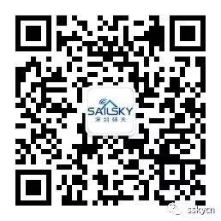
07
Physical properties
Physical properties
Temperature characteristic | Working temperature: 0°C~55°C
 | Storage temperature: -20°C to 70°C
Humidity | 5%~95% (typical)
National Customer Service Number ：0755 - 27209470
Shenzhen Shuotian Information Technology Co., Ltd
5B-18, Shenzhou Computer Building, No.2 Beier Road, Longgang District, Shenzhen
Web：www.sskycn.com
E-mail：sales@sailsky.cn
Tel：0755-27209470
PC：518000
10
www.sskycn.com

Slide 11
Copyright©2020 Shuotian Information Technology Co., Ltd. All rights reserved

