Slide 1

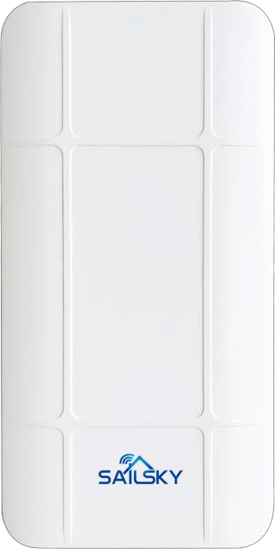


SY205
Outdoor CPE 2.4GHz 300Mbps
www.sailskywifi.com
Product Description：
SY205 is an economic outdoor CPE/AP with 300Mbps transmission data rate. It Complies with IEEE 802.11b/g/n WiFi standard, adopt Qualcomm QCA9531 chipset, build in 14dBi directional antenna, The transmit/receive wireless distance could reach up to more than 1KM. It supports AP, Gateway, WISP, Repeater, WDS Mode. The most effective solution for PTP, PTMP application and outdoor long range WIFI coverage application. It equips with ABS waterproof, dust-proof and sunscreen shell, temperature adaptive and board protective. Meantime, it supports 24V passive POE, easy to setup even no power socket nearby, ideal for outdoor use. Besides that, SY205 with digital display, easy to be pairing, simple configuration, make this device is widely used in CCTV, Village long range data transmit, Park, Squares...

Slide 2

www.sailskywifi.com
Product Features：
※ Cost-effective hardware configuration
Build-in Qualcomm QCA9531 chipset, industrial grade circuit design, 8MB Flash/64MB SDRAM, support IEEE802.11b/g/n protocol, can provide 300Mbps wireless access speed, excellent anti-high and low temperature design, enhance the user experience in extreme environment.
※ 14dBi High Gain Antenna, Long Range Wi-Fi Device in market
SY205 with 14dBi high gain antenna, the Wi-Fi range is more than 1km, it is the device with very stable performance in long range
※ Support Power over Ethernet(PoE)
The device has integrated Power over Ethernet (PoE) for easy installation and lower cost, with 24V PoE, it can be installed in areas where power outlets are not readily available, eliminating the mess of altering existing network infrastructure.
※ Stylish compact, simple and flexible installation
Stylish appearance, supports the wall/pole fixed installation mode, flexible installation, greatly reduces the construction difficulty and improves the construction efficiency without affecting the original design.
※ IP66 dust-proof and waterproof, suitable for a variety of harsh environments
The enclosure is IP66 rated for outdoor dust, water and sun protection. It can work normally in extreme environments as low as -30 ° C up to 55 ° C. It can easily adapt to the harsh outdoor environment and ensure stable operation of the network for 24 hours.
Hardware
Model | SY205
Chipset | Qualcomm QCA9531
CPU Clock Speed | 550MHz
Standards | 2.4GHz 802.11b/g/n
RAM | 64MB
Flash | 8MB

Slide 3

www.sailskywifi.com
Hardware
Interface | 1*LAN+1*WAN 10/100Mbps RJ45
Button | 1*Reset Button， Long press to reset, short press to adjust digital display number
Power Consumption | <12W
Power Supply | POE：24V 0.5A，DC：12V 1A
working environment | Temperature：-40℃～+55℃（operating），-20℃ ～+70℃（storage）Humidity（no-condensing）：5 ％～90％（operating），5％～95％（storage）
Size | 172*90*57(mm)
Weight | 0.5KG
Toggle switch | Define product AP Mode and Repeater Mode
Radio frequency Feature
Frequency Range | ISM band: 2.400 ~ 2.4835 GHz
Channel | 2G:1、2、3、4、5、6、7、8、9、10、11、12、13
Modulation method | OFDM = BPSK, QPSK,16-QAM,64-QAM; DSSS = DBPSK, DQPSK, CCK
Output power | 2.4G: 11n @MCS0~2/MCS8~10:27±1dBm @MCS7/MCS15:23±1dBm 11g @6~24M:27±1dBm @54M:23±1dBm 11b @1~11M:27±1dBm
Receiving sensitivity | 2.4G: 11n: -86dbm@MCS0 -68dbm@MCS7 - 86dbm@MCS8 -64dbm@MCS15 11g: - 90dbm@6Mbps -68dbm@54Mbps 11b: - 90dbm@1Mbps -85dBm@11Mbps
EVM | 802.11n: ≤-29 dB 802.11g: ≤-26 dB802.11b:
Frequency offset | ±20ppm

Slide 4

www.sailskywifi.com
Software Feature
Working Mode | Router, Universal Repeater, WISP, AP and Repeater
Users | 32
Network | Controller address /DHCP/ static IP
System | Restore factory/system restart

