Slide 1
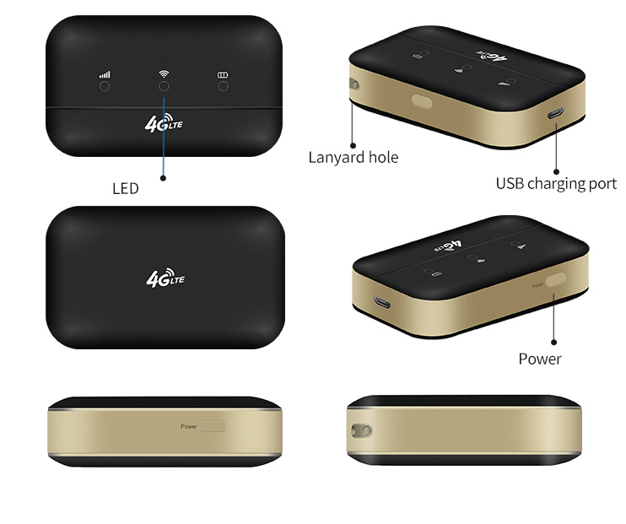
http://www.sskycn.com/
XM41
4G Mobile Wifi Hotspot
Product introduction:
The XM41 4G Mobile WiFi Hotspot
XM41 is a new 4G pocket WiFi router. XM41 is a LTE Category 4 mobile hotspot which could support peak download speed to 150Mbps.
Key Feature
- Able to connect with tablet pc,notebook and different types of wifi devices
- High speed to link, LTE download speed up to 150M
- Friendly user interface
- Maximum 5-6 hours working by battery 3000mah
- 10 Users connection support
SHENZHEN SHUOTIAN INFORMATION & TECHNOLOGY CO., LTD

Slide 2
http://en.sskycn.com/
Product Features:
Multi mode to work
First you need to put sim card, And charge it by usb cable.Also no need to connect usb cable cause it's have 3000mah battery .it will keep working till power offer. In this case, XM41 should be a good partner whenever you are at home or outside. It's easy to take and easy to use, worthy to have it.
Fast Connection
A secure download speed of 150 Mbps and a fast uploadspeed of 50 Mbps allowing you to stream or download videos and films in no time!
Travel
Travelling to a different country and have no access to Internet connection? Purchase a XM41 and you will have no problem connecting to the Internet abroad. All you need to do is buy a data sim card from the local area you will be staying in, connect, then there you go Internet access on holiday or from home.
Perfect for Small Businesses
XM41 allows you to you to share your Internet connection with up to 10 different Wi-Fi enabled devices. Perfect for cheap data roaming in your office. Giving you the best Internet experience at home and at work.
SHENZHEN SHUOTIAN INFORMATION & TECHNOLOGY CO., LTD

Slide 3
http://en.sskycn.com/
Hardware
Model | XM41
Platform | ZX7520m
Dimension (L × W × H) and Weight | 99*60*27.5mm(0.2kg)
Frequency Band | FDD band: B1/B3/B5/B7/B8/B20 TDD band:B38/B40/B41 UMTS:B1/B5/B8
Wi-Fi | IEEE 802.11b/g/n
Transfer rate | 3GPP R9 ,Category 4, DL 150Mbps UL 50Mbps
Encryption | Wi-Fi Protected Access™ (WPA/WPA2)2
LED Indicators | Battery Capacity，WIFI，Signal indicators
Internet
Wi-Fi | Wi-Fi AP， Up to 10 users
WIFI SSID | 4G-WIFI-****
SHENZHEN SHUOTIAN INFORMATION & TECHNOLOGY CO., LTD

Slide 4
http://en.sskycn.com/
WIFI password | 1234567890
Interface
Micro USB | 1A Charge IN RNDIS
SIM | 3GPP 31.101 and 31.102 standard
Micro SD | Up to 32GB（Or MICRO SIM）
KEY | one Power button, one RESET key
Operating Environment
Operating Temperature | 0℃～+45℃
Extreme working temperature | -20℃～+60℃
Storage Temperature | -20℃～+25℃
Relative humidity | 45%～85%
WEB
Gateway | http://192.168.0.1
Log in | User name ：admin Password：admin Language(Chinese/English)
Status | Connection; APN;IP; Signal Strength; Battery Capacity; Conneting time; Users
Networks | APN confirguration: International roaming switch, APN, User name, Password, Authorization type modification, New APN, Restore defaulf APN parameters. Traffic statistics: Traffic Limitation: Afering reaching the set value, limit the speed as set.
Wifi | WLAN configuration: SSID modifiation, encryption methods, encryption password, Maximum user number setting, support PBC-WPS
System Management | Login password management: User name, password modification System operation: Restart, Shutdown, Restore factory setting System Information: Check software version, WLAN MAC address, IMEI NO. Phonebook setting: New, modify, look up, delete contact
SMS Management | SMS open, delete, send
Micro SD | WEB sharing
SHENZHEN SHUOTIAN INFORMATION & TECHNOLOGY CO., LTD

