Slide 1
Data book
BL series of ceiling AP
BL 270Q
Document version number: V1.0
Copyright©2020 Shuotian Information Technology Co., Ltd. All rights reserved

Slide 2
Directory
1. Product characteristics·····························································4
2. Packing list·················································································5
3. Application scenarios································································6
4. Hardware specifications····························································8
5. Radio frequency parameters····················································8
6. Software features····································································10
7. Physical properties··································································11
8. Contact information································································11
2
www.sskycn.com

Slide 3
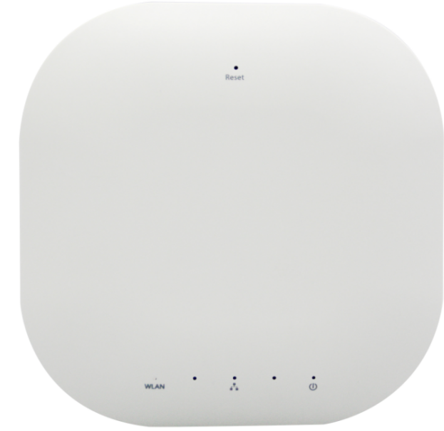
BL270Q - Wireless access point
The BL270Q is a high-performance, high-speed, high-power indoor dual-band ceiling AP that can provide 2.4G and 5GHz dual-band wireless services, providing a cleaner wireless environment and more stable wireless access. Support intelligent channel analysis and automatic selection of optimal channel, suitable for dense distribution of wireless network coverage.
BL270Q is mainly applied to schools, hospitals, stations, cafes, hotel lobbies, large office Spaces, large shopping malls and other densely populated places as WiFi coverage.
01
Product characteristics
3
www.sskycn.com

Slide 4
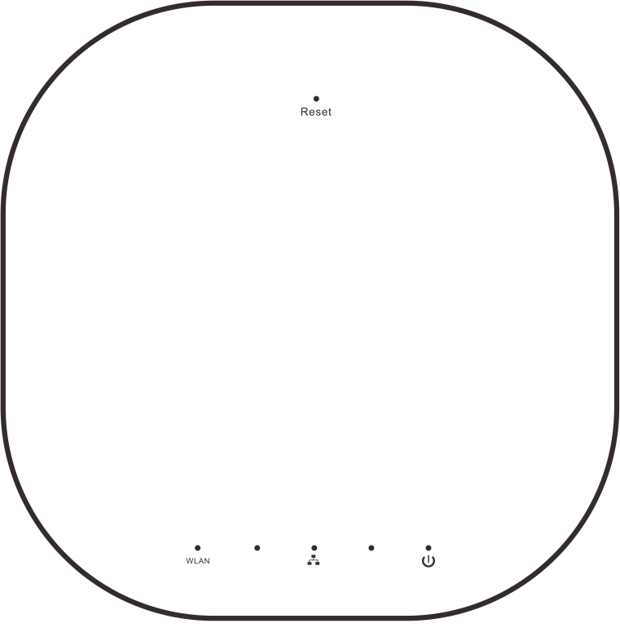
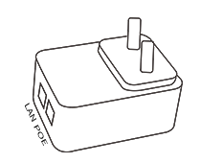
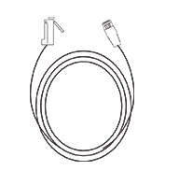
02
Packing list
BL270Q ×1
Power adapter×1（48V0.5A)
Cable×1
（1 meter）
Product specification×1
4
www.sskycn.com

Slide 5
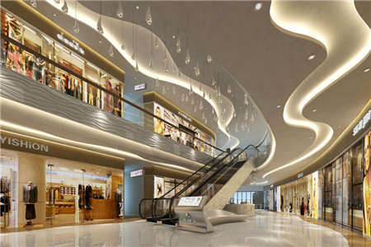
03
Application scenarios
1. Office, classroom and other indoor places
2. Shopping malls, supermarkets and other places
5
www.sskycn.com

Slide 6
3 . Restaurants, cafes and other places
4. Hotel and other places
6
www.sskycn.com

Slide 7
04
Hardware specifications
Hardware specifications
Chipset | Qualcomm 9531+9887 chipset
Frequency | 660MHz
Wireless teconology | 802.11AC, 750M MIMO Teconology
Memory | 64MB DDR2
Flash | 8MB SPI
Device interface | one 10/100 Mbps adaptive wired network interfaces
 | One reset button, restore the default settings used
 | One DC power interface, POE: 48V, 12V DC /2A
Size | 300mm*190mm*60mm
Weight | 0.65kg
Power consumption | 500mW
Power Supply | POE: 48V, DC 12V /1.5A
05
Radio frequency parameters
Radio frequency parameters
Modulation mode | OFDM = BPSK,QPSK, 16-QAM, 64-QAM 256-QAM
 | DSSS = DBPSK, DQPSK, CCK
Transmission rate | 750 Mbps
7
www.sskycn.com

Slide 8
05
Radio frequency parameters
Radio frequency parameters
Acceptance sensitivity | 802.11n(2.4GHz) | 802.11g | 802.11b
 | -90dBm @ MCS0 | - 90dBm @ 6Mbps | - 95dBm @ 1Mbps
 | -70dBm @ MCS7 | - 72dBm @ 54Mbps | - 93dBm @ 11Mbps
 | -90dBm @ MCS8
 | -68dBm @ MCS15
Transmission power | 802.11n(± 1.0dBm) | 802.11g(± 1.0dBm) | 802.11b(±1.0dBm)
 | 24dBm@ MCS0~2/MCS8~10 | 26dBm @ 6~24Mbps | 26dBm @1~11Mbps
 | 24dBm @ MCS3/MCS11 | 25dBm @ 36Mbps
 | 24dBm @ MCS4/MCS12 | 24dBm @ 48Mbps
 | 24dBm @ MCS5/MCS13 | 24dBm @ 54Mbps
 | 24dBm @ MCS6/MCS14
 | 24dBm @ MCS7/MCS15
Receiving sensitivity | 802.11AC(20MHz) | 802.11AC(40MHz) | 802.11AC(80MHz)
 | -68dBm | -65dBm | -62dBm
Transmission power | 802.11AC 20dBm (± 1.0dBm)
Radio frequency characteristics | 2.4G:Support 802.11b/g/n: 5GHz：802.11a/n/ac
 | 2.4GHz、5GHz
8
www.sskycn.com

Slide 9
06
Software features
Software features
Working mode | AP mode
Communication standard | IEEE 802.3(Ethernet)
 | IEEE 802.3u(Fast Ethernet)
 | IEEE 802.11b/g/n(2.4G WLAN)
 | IEEE 802.11a/n/ac（5G)
Wireless settings | Intelligent channel analysis
 | Distance control 802.1 X ACK time output
 | Multiple SSIDs, up to eight can be configured（Support Chinese SSID）
 | BSSID
Wireless security | WEP security mechanism support 64/128/152 bit WEP security code
 | WPA/WPA2 security mechanism (WPA-PSK use TKIP or AES)
 | WPA/WPA2 security mechanism (WPA-EAP use TKIP)
 | Hide the SSID security mechanism
System settings | WEB configuration
Software upgrade | WEB page
User management | Configurable user and password
System monitoring | Device and network status statistics
Log | Provide local log, host log, file transfer log
Restore settings | The default settings can be recovered
Backup function | System configuration can be backed up and user configuration can be restored when needed
9
www.sskycn.com

Slide 10
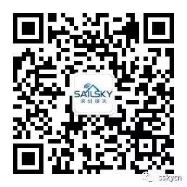
07
Physical properties
Physical properties
Temperature characteristic | Working temperature: 0°C~55°C
 | Storage temperature: -40°C to 70°C
Humidity | 5%~95% (typical)
Accessories list | Fixed screw qualification certificate
National Customer Service Number ：0755 - 27209470
Shenzhen Shuotian Information Technology Co., Ltd
5B-18, Shenzhou Computer Building, No.2 Beier Road, Longgang District, Shenzhen
Web：www.sskycn.com
E-mail：sales@sailsky.cn
Tel：0755-27209470
PC：518000
10
www.sskycn.com

Slide 11
Copyright©2020 Shuotian Information Technology Co., Ltd. All rights reserved

