Slide 1


Data Sheet
11AX Super Mesh Router
Updated on 17th, May, 2021
www.sskycn.com

Slide 2

Directory
1. Description·······································2
2. Main Features ··································3
3. Hardware specifications······················7
4. Firmware features······························8
5. Application scenarios··························9
6. Packing list······································11
7. Contact information···························12
www.sskycn.com

Slide 3
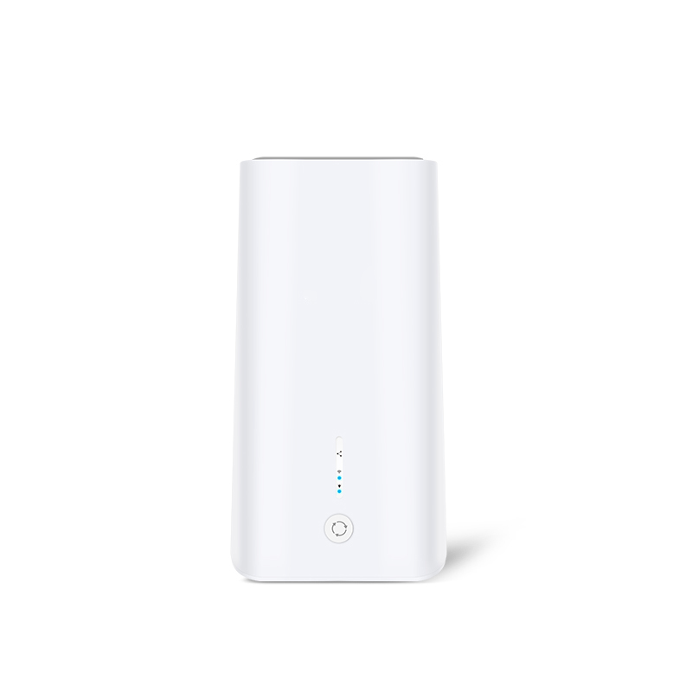
WiFi6 1800Mbps Mesh Router
M18 is an 11ax Wi-Fi6 standard super mesh router, dual band, 1800Mbps high speed, Gigabit WAN/LAN ports, easy mesh, APP control, IPV6 and TR069 supported, best choice for ISP, retail and branded customers.
01
Description
www.sskycn.com

Slide 4
1800Mbps 160MHz fast speed
Comply the latest WiFi6 standard, dual band with 1800Mbps high speed. MU-MIMO, DL/UL-OFDMA modulation, 5G prior, all make users automatically selects the best connection, to keep the running ultra-fast.
02
Special Features:
www.sskycn.com

Slide 5
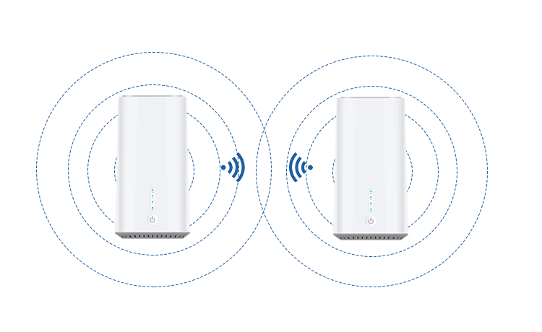
Seamless stable Mesh
Simply to press the mesh button, 2~3PCS wifi router connect fast and provide whole home Wi-Fi coverage;
Seamless roaming tech ensure your device switch to the strongest Wi-Fi signal always even move from room-to-room.
02
Special Features:
www.sskycn.com

Slide 6

APP easy control
Download APP, auto search, found, setting, finish, your home networking in controlled in your mobile phone everywhere.
02
Special Features:
www.sskycn.com

Slide 7
03
Hardware specifications
Hardware specifications
Model | M18
CPU | MT7621DAT+MT7905N+MT7975DN
Flash | 16MB
Memory | 128MB DDR3
Ethernet | 1*10/100/1000Mbps WAN, 2* 10/100/1000Mbps LAN
Button | Reset button
 | MESH Button
Switch | MESH+ LED Switch
LED Indicator | MESH+ Working Status (breathing light)
 | 2.4G Wi-Fi
 | 5.8G Wi-Fi
 | System Status
 | Power Status
Antenna | Build in 5dBi MIMO Antenna
Power Consumption | <15W
DC Power Supply | 12V/1.5A
Working temperature | Working Temperature:-20℃～55℃ Storage temperature: -30℃～70℃
Humidity | 5%～95%
Dimensions | 108mmX108mmX216mm
Weight | TBD
www.sskycn.com

Slide 8
04
Firmware Features
WIFI6（802.11ax）
WiFi Standard | IEEE 802.11b/g/n/ac/ax
Frequency | 2.4G: 2400 - 2484MHz 5.8G: 5150 - 5850MHz
Data Rate | 600Mbps @ 2.4GHz 1200Mbps @5.8GHz
RF Power | ≤ 18dBm
Access Users | 100+ Clients
IP Protocol | IPv4/IPv6
Operation mode | Router/Mesh
Security | Open, WPA, WPA2PSK_TKIPAES, WAP2_EAP, 802.1x, WPA3
Wireless Functions | Multiple SSID functions: 2.4GHz: 4; 5.8GHz: 4.
 | Support SSID hidden
 | Support seamless roaming, 802.11kvr standard.
 | Support 5G Prior for a faster Ethernet.
 | Support MAC filter
 | Support client isolation to improve the wireless stability
VPN | VPN Passthrough and VPN Client (L2TP PPTP)
Device Management | APP Control
 | GUI web management
 | Support firmware back-up, restore, reset, upgrade
www.sskycn.com

Slide 9

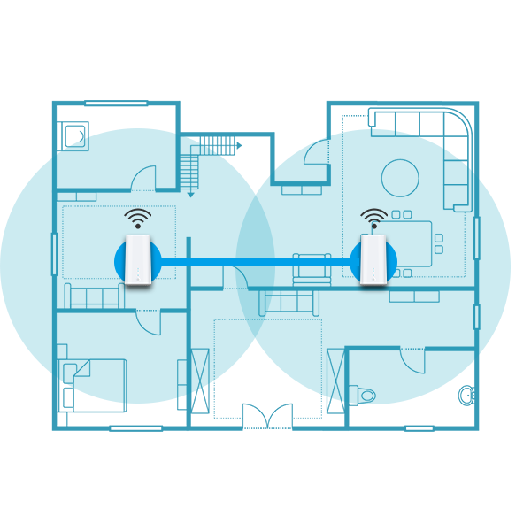
05
Application scenarios
1. 1PC for small house (50~80 square meters)
2. Main router and slave router for middle size house (80~130 square meters)
www.sskycn.com

Slide 10


05
Application scenarios
3. Main router and slave router for villa
4. Main router and slave router for office
www.sskycn.com

Slide 11


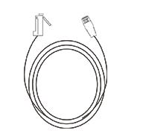

06
Packing list
Power adapter×1
（12V1.5A)
M18×1
Cat 6 LAN Cable×1
（1 meter）
User Manual×1
www.sskycn.com

Slide 12

Welcome to visit us for more info or quotation:
SHENZHEN SHUOTIAN INFORMATION TECHNOLOGY CO.,LTD
5/F,Shenzhou Building,Bantian Street, Longgang District, Shenzhen,Guangdong Province,
Web：www.sailsky.com
Email:lin@sskycn.com
Tel：86-13631482895 PC：518000

