Slide 1
Data Sheet
11N 300Mbps Outdoor LTE CPE
Updated on 24th, May, 2023
www.sailskywifi.com

Slide 2
Directory
1. Description·······································3
2. Main Features ··································4
3. Hardware specifications······················5
4. Firmware features······························6
5. 4G features·······································7
6. Application scenarios··························8
7. Packing list······································10
8. Contact information···························11
www.sailskywifi.com

Slide 3
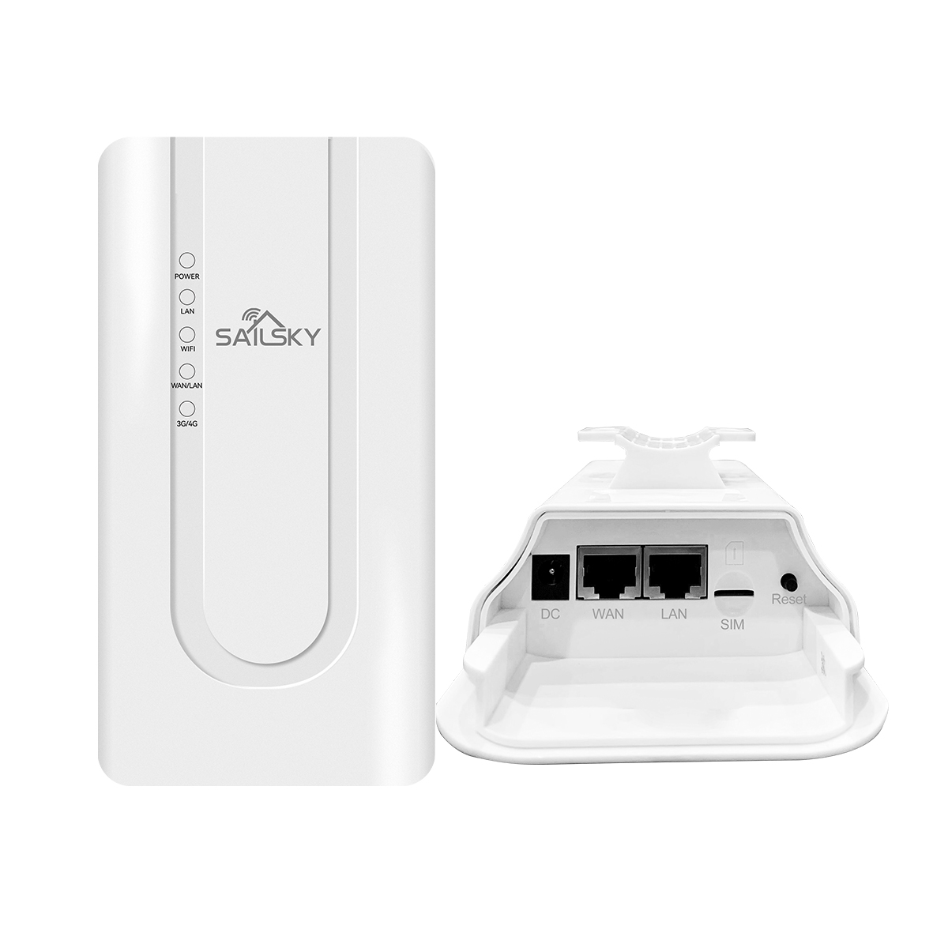
High Speed Outdoor LTE CPE
XM207 is wide-use outdoor 4G CPE supports with 50~100 meters wireless range; Comply with IEEE 802.11b/g/n MIMO standard, the Wi-Fi data rate up to 300Mbps, more than 32 end users can access into it; With SIM card slot, it support FDD-LTE/TDD-LTE for worldwide use with 150Mbps downlink speed.
01
Description
www.sailskywifi.com

Slide 4
Outdoor industrial design, 300M wireless
It adopts an outdoor IP65 windproof, rainproof, dustproof, and sunscreen protection grade shell design, which can easily adapt to various harsh outdoor environments. Built-in professional wireless processor, wireless rate up to 300Mpbs, barrier-free transmission distance of about 100 meters, independent professional power amplifier and low-noise amplifier, stable and smooth with 30 units, no freeze, no drop.
Powerful never crash system
Dual SOC hardware design, self-contained system detection mechanism, self-contained 4G network detection mechanism, self-contained intelligent recovery mechanism, long-term stable operation, never crash．
Easy to set up, one machine is flexible and multi-purpose．
Default 4G access mode, plug and play. Support 4G mode, router mode, AP mode switching, built-in quick setup wizard to guide customers to complete the configuration easily. Router mode supports wired broadband access; AP mode easily converts wired network into wireless WiFi network. It supports 4G and wired broadband access methods, and supports China Mobile Unicom Telecom 4G/3G/2G network cards. It has the advantage of 4G Internet access in places where wired bandwidth cannot reach, and it is easy to access the Internet.
02
Main Features Features:
www.sailskywifi.com

Slide 5
A variety of security strategies to ensure network data security at all times
Support WPA, WPA2 wireless security access, support SSID hiding and wireless blacklist to effectively prevent network fraud, and ensure user network data security at all times.
TR069 Remote Management
Support real-time viewing of device status parameters, batch remote device management, status notification, device agent management, so that the device can be managed and controlled.
A variety of status statistics, always know the working status of the equipment
Built-in traffic statistics, support traffic package settings, easy to understand the monthly traffic usage; multi-state work indicator, real-time work log view, always know the working status of the device.
Non-stop product function update and performance optimization
The R&D team adhering to the spirit of craftsmanship has been constantly updating functions to meet the needs of various network environments simply and efficiently; meticulous performance optimization ensures the provision of the highest quality network products and improves user experience.
02
Main Features Features:
www.sailskywifi.com

Slide 6
03
Hardware specifications
Hardware specifications
Model | XM207
Chipset | MTK7628KN 300M high-performance enterprise chip
Flash | 2MB
Memory | 8MB
Ethernet | WAN 10/100Mbps adaptive network interface*1 LAN 10/100Mbps adaptive network interface*2 SIM card, big card
Button | Reset button
SIM/USIM | 1* SIM card
LED Indicator | 5 groups: POWER, LAN, WIFI, WAN/LAN, 3G-4G
Antenna | 4G 2T2R 5dBi antenna*2 WiFi 2T2R 2.4G 5dBi Antenna*2
ESD
Power Consumption | <10W
PoE Power Supply | POE 24V 0.5A/DC 12V 1A
Protection level | IP65 level
With package size | 192mm*99mm*106mm
With package Weight | 400g
www.sailskywifi.com

Slide 7
04
Firmware Features
WIFI Standard
WiFi Standard | IEEE 802.11b/g/n, 2X2 MIMO
Frequency | 2.4G: 2400 - 2484MHz
Data Rate | 300Mbps @ 2.4GHz
RF Power | ≤ 20dBm
Access Users | 32+ Clients
IP Protocol | IPv4
Operation mode | 4G/WAN/AP
Security | WPA/WPA2 security mechanism (WPA-PSK uses TKIP or AES)
Network Configuration | Operating mode LAN port/WAN address setting APN settings
Traffic assistant | Traffic statistics/package settings/traffic control
 | Support Mac/IP address filter
 | Support Port forwarding, DMZ, static router and QoS
Management | GUI web management, TR069
 | Support firmware back-up, restore, reset, upgrade
Language | English/Chinese
Login Info | IP address: 172.16.0.1
 | 4G-WiFi-XXXX (the last 4 digits of the MAC address)
 | SSID: 12345678
www.sailskywifi.com

Slide 8
05
4G Features
4G Spec
Maximum Data Throughput | LTE CAT 4 FDD/TDD: up to 150Mbps DL; up to 50Mbps UL WCDMA: HSDPA up to 42.2Mbps DL; HSUPA up to 11.5Mbps UL EVDO: 3.1Mbps DL
Technical Standard | Compatible with FDD-LTE, TDD-LTE, WCDMA, EVDO Default 802.11b/g/n
Frequency | LTE-FDD:B1/B3/B5/B7/B8/B20/B28 LTE-TDD:B38/B40/41 WCDMA:B1/B5/B8 GSM:900/1800mhz
Light Blinking Rules
POWER | Connect to the power supply, the POWER light is always blue
2.4G | 2.4G WiFi is turned on, and the 2.4G indicator light is always blue
4G | In 4G network mode, and when the 4G network is normal, the 4G light is always on in blue; in 4G mode, the 4G light is abnormal, and the blue light flashes
WAN | When there is data access, the WAN indicator light is always blue
LAN1/LAN2 | When there is data access, the indicators of LAN1 and LAN2 are always blue
Working Environment
Operating Temperature | Normal:-10°C ~ 50°C;
Storage Temperature | -40° C ~ 70° C
Humidity | 5%~ 95%
www.sailskywifi.com

Slide 9
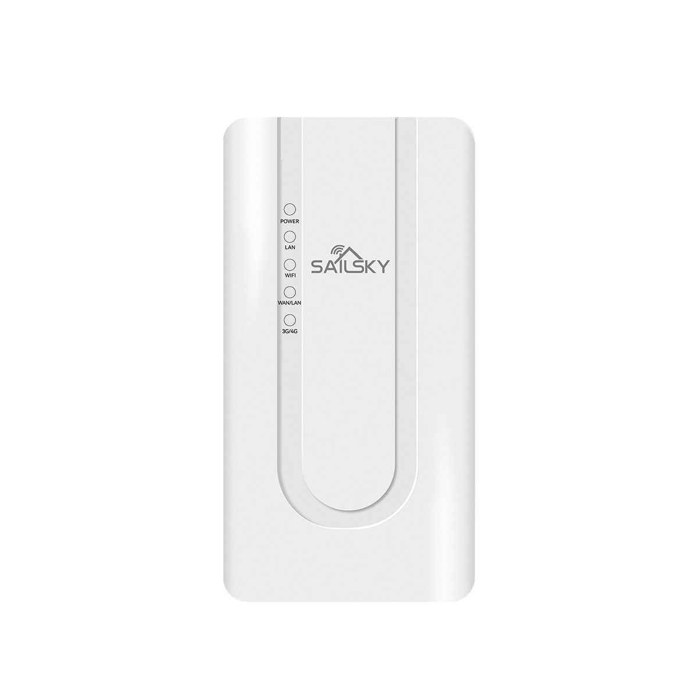
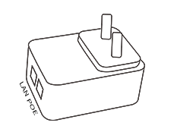
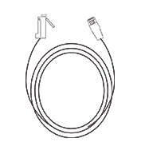
07
Packing list
XM207×1
PoE Power adapter×1
（24V 0.5A)
Cat 6 LAN Cable×1
（1 meter）
User Manual×1
Hose clamp×1
www.sailskywifi.com

Slide 10
Welcome to visit us for more info or quotation:
SHENZHEN SHUOTIAN INFORMATION TECHNOLOGY CO.,LTD
5/F,Shenzhou Building,Bantian Street, Longgang District, Shenzhen,Guangdong Province,
website ：www.sailskywifi.com

