Slide 1
Datasheet
BL seriels（Support intrinsically safe power supply）
BL 5000X
File version No: V1.0
Copyright©2020 硕天信息技术有限公司，保留所有权利

Slide 2
Power and responsibility statement
No content of this publication may be reproduced, disseminated, transcribed, stored in a retrieval system, or translated into any human or computer language, in any form or by any means, without the written permission of the Company. The use of unauthorized copies of products not only infringes copyright but may prevent Shuotian Information Technology from providing accurate and up-to-date information to users and operators.
is the trademark of Shenzhen Shuotian Information Technology Co., Ltd. All other trademarks, product logos and trade names mentioned in this manual are the property of their respective owners.
The content of this manual is subject to change due to product version upgrade or other reasons. Shuotian Information Technology Co., Ltd. reserves the right to modify the content of this manual without any notice or prompt. In laws and regulations allow range, day to recognize Shuotian information technology co., LTD., in any case, all wrong because of the use of this product manual or this website content and cause of the accident, negligence, contract damage, defamation, copyright or intellectual property infringement and any special, incidental, indirect, secondary loss compensation, no any profits, data, and to compensate the loss of goodwill or anticipated savings, also does not assume any legal liability.
Security statement
Please read the safety and compatibility information of the product before powering it up.
Environmental statement
The product conforms to the design requirements of environmental protection. The storage, use and disposal of the product shall comply with the requirements of relevant national laws and regulations.
Revision record
The revision record accumulates the notes for each manual update, and the latest version of the manual contains all previous manual updates.
www.sailskywifi.com

Slide 3
Directory
1. Product characteristics················································ ··········4-5
2. Application scenarios····························································6-7
3. Hardware specifications·····························································8
4. Wlan Specification····································································· 9
5. Receive sensitivity····································································10
6. Wlan antennas Specification················································11
7. Power and Power Consumption··············································11
8. Software features·····································································12
9. LED·················· ·······································································13
10. Physical properties································································13
11. Environmental indicators·······················································13
12. Contact Details······································································14
www.sailskywifi.com

Slide 4
01
Product characteristics
BL5000Air – Wifi6AP wireless client
BL5000Air is a (802.11ax) standard Wi-Fi 6 client. This product adopts Qualcomm wifi6 solution architecture, which can support 2.4GHz (2×2) + 5.8GHz (2×2) dual-band simultaneous service, the whole machine speed is up to 3Gbps, of which 5.8G supports 20/40/80/160Mhz, the highest Bandwidth 2400Mbps, 2.4G supports 20/40Mhz maximum bandwidth 574Mbps (network port Gigabit).
The hardware design of the product meets the requirements of intrinsic safety, and the reliable multi-level power protection and port protection design can ensure that the BL5000Air wireless product can work in harsh industrial control environments for a long time, and at the same time solve the hidden danger of high power consumption.
Ultra-miniature design concept, terminal interface, stable and shock-resistant, can be built into robots, cameras, handheld remote controls, explosion-proof boxes, AGV and other equipment.
It can be widely used in industrial applications, mining intrinsic safety, mobile robot inspection, high-bandwidth communication and other industrial applications.
In terms of performance, BL5000Air has superior wireless reception performance, strong anti-interference, and supports millisecond-level seamless fast switching roaming technology. The new wireless technology has changed the iteration from traditional mines to intelligent ones, and there are few specialized low-latency roaming technologies. With the support of the manufacturer, the BL5000Air client and the BL6000X base station can be used together to provide low latency, high bandwidth compatibility, low cost, and long-distance combination. It is more suitable for communication environments such as underground coal mines, storage, and robot inspections. It is widely used in complex industrial wireless communication systems.
www.sskycn.com

Slide 5
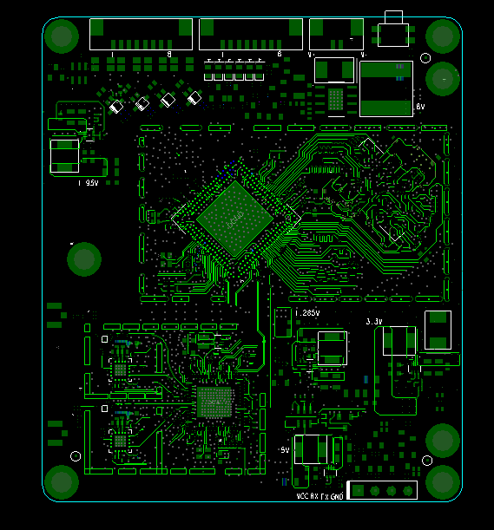
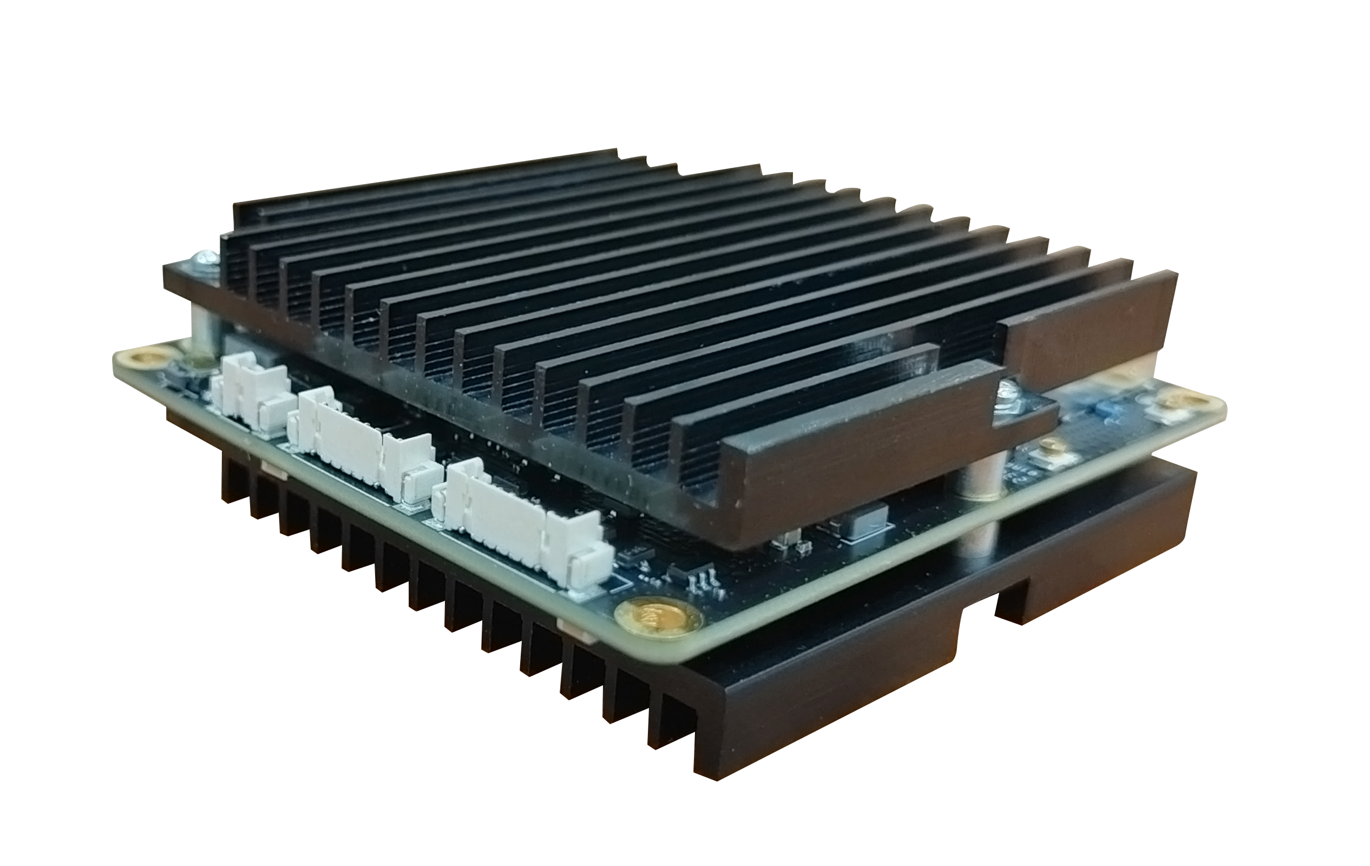
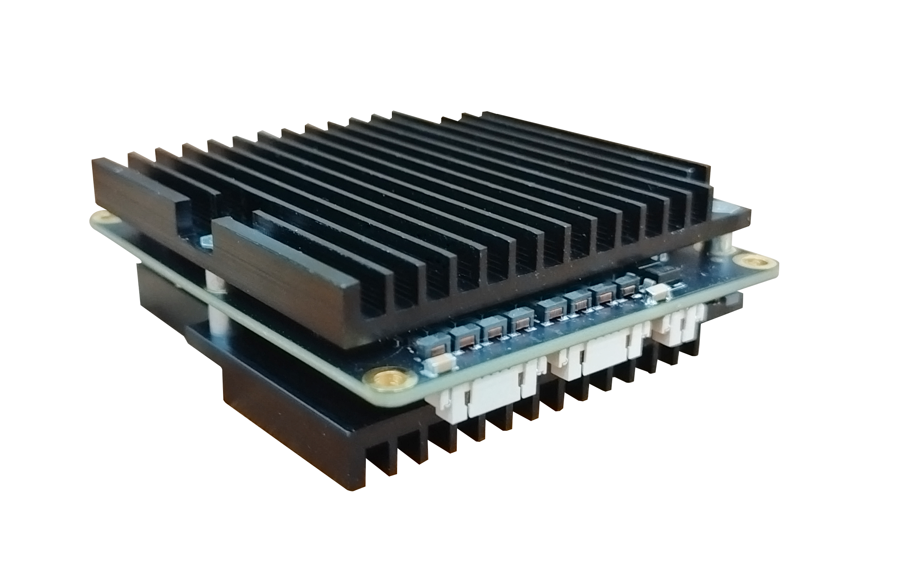
BL5000Air supports omnidirectional/directional antennas, dual radio 2.4GHz+5GHz working simultaneously, supports 1×GE electrical port (LAN), 1×GE electrical port (WAN).
Support 8KV overvoltage protection for Ethernet interface, and work at a wide temperature range of -40°C~+70°C, fully meeting the requirements of industrial use;
● Low power consumption design of the whole machine, WIFI stand-alone full-load power consumption ≤ 9W.
No matter from a technical point of view or an economic point of view, all kinds of underground applications are inseparable from the support of wifi technology, including wifi voice calls, data collection and transmission, wireless video transmission, etc.
BL5000Air realizes fast wireless transmission on intelligent robot inspections, monorail cranes, and tram locomotives. These are inseparable from our accumulation of Wifi technology, which makes us gradually become a high-quality supplier of mine communications.
www.sskycn.com

Slide 6
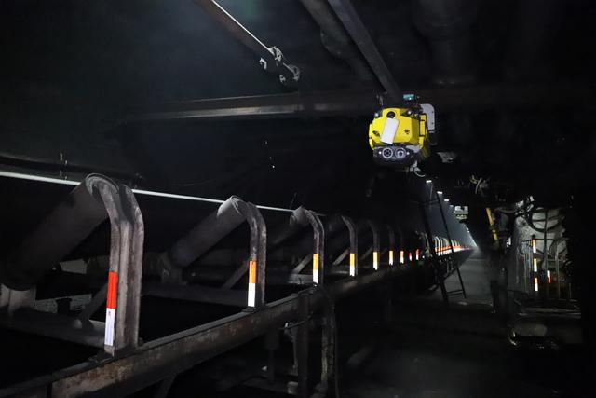
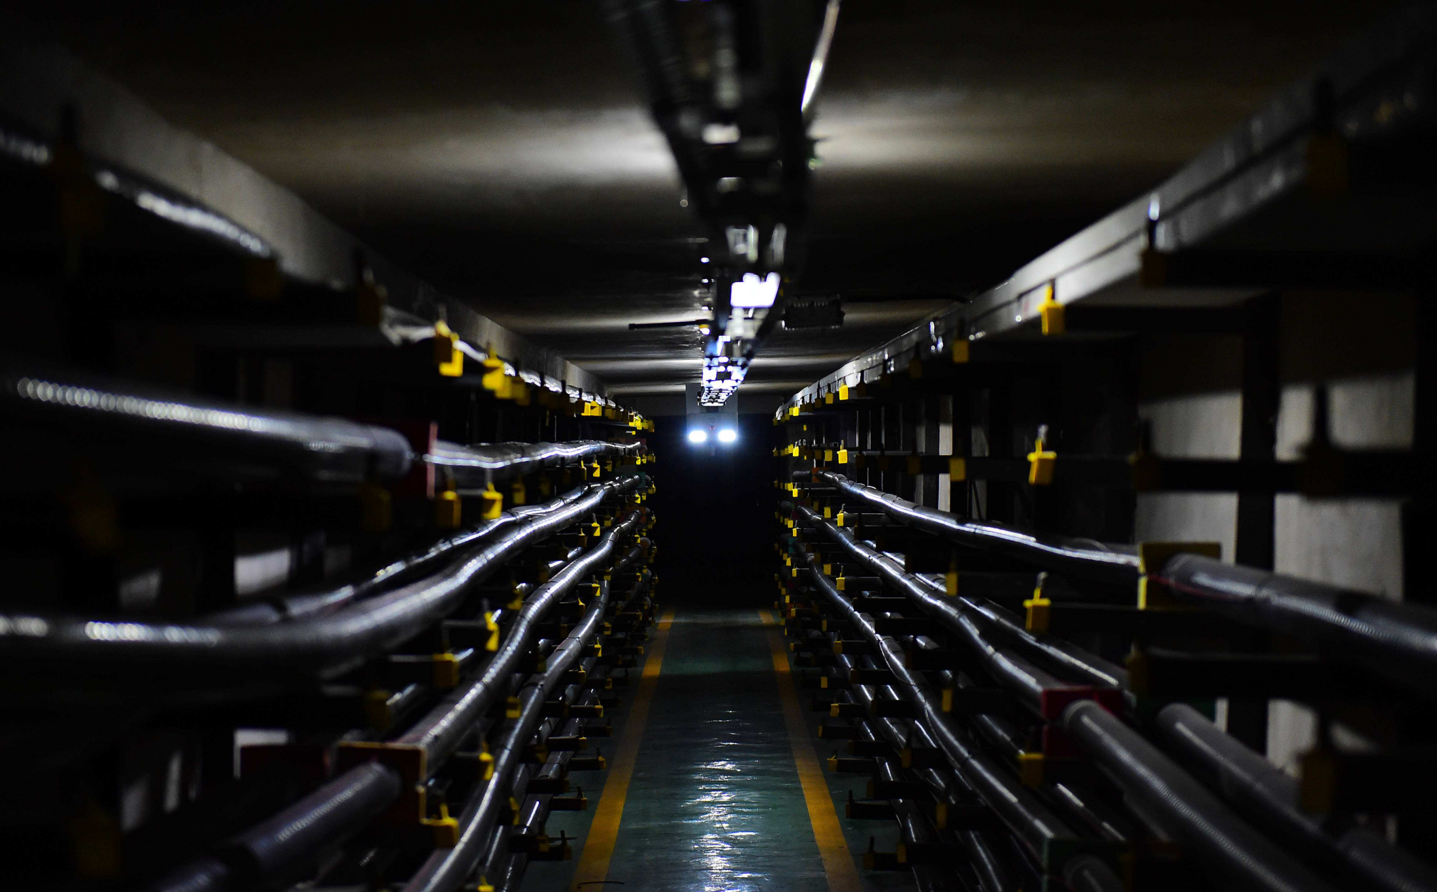
01
Application scenarios
1. Smart mine
2.corridor
www.sailskywifi.com

Slide 7
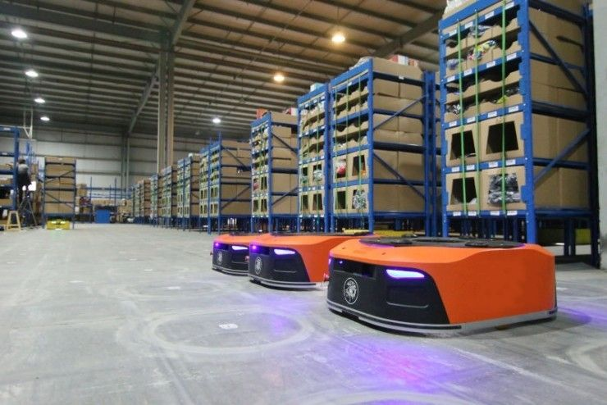
3 .Power inspection
4. warehouse logistics
www.sailskywifi.com

Slide 8
02
Hardware specification
Hardware Configuration
Model | BL5000Air
Chipset | IPQ5018+6102
Momory | 4Gb DDR3
Flash | 1Gb Nand Flash
Size | 39*23*11cm
Weight | 0.15KG
Power consumption | ≤9W
Reset button | reset button（Press and hold for 10 seconds to restore the factory default configuration）
Status indicator | System light + power light + 2.4G light + 5.8G light + 2 network port lights
Antennas | 2 IPEX antenna mounts (2G and 5G with duplexer combined)
Power supply | DC wide voltage 9-24v input, thyristor protection, overvoltage protection, anti-reverse connection
Interface | 2 10/100M/1000M network ports (1.25-8P connector)
 | 1 power supply terminal (1.25-2P connector)
 | 1 reset button, built-in 1 debugging serial port
 | Terminal Block and Antenna IPEX Holder, Vertical
www.sskycn.com

Slide 9
03
WALN Standard
WLAN ±2 dB | 2.4GHz | 5GHz
11 b (1Mbps) | 23 | -
11 b (11Mbps) | 23 | -
11 g (6Mbps) | 23 | -
11 g (54Mbps) | 20 | -
11 a (6Mbps) | - | 24
11 a (54Mbps) | - | 22
HT20(MSC 0/8) | 23 | 24
HT20(MSC 7/15) | 20 | 22
HT40(MSC 0/8) | 23 | 24
HT40(MSC 7/15) | 20 | 22
VHT80 256QAM MCS0 |  | 23
VHT80 256QAM MCS9 |  | 19
VHT80 1024QAM MCS0 |  | 22
VHT80 1024QAM MCS11 |  | 17
cn.sskycn.com

Slide 10
04
Receive Sensitivity
Receive Sensitivity (per chain)±2 dB
 | 2.4GHz | 5GHz
802.11b | -95
11 g (6Mbps) | -92 | -
11 g (54Mbps) | -75 | -
11 a (6Mbps) | - | -94
11 a (54Mbps) | - | -77
HT20(MSC 0/8) | -92 | -92
HT20(MSC 7/15) | -72 | -74
HT40(MSC 0/8) | -88 | -90
HT40(MSC 7/15) | -70 | -72
VHT20 256QAM @ 3/4 Code Rate | - | -90
VHT20 256QAM @ 5/6 Code Rate | - | -71
VHT40 256QAM @ 3/4 Code Rate | - | -88
VHT40 256QAM @ 5/6 Code Rate | - | -66
VHT80 256QAM @ 3/4 Code Rate | - | -86
VHT80 256QAM @ 5/6 Code Rate | - | -61
VHT80 1024QAM MCS11 | - | -51
cn.sskycn.com

Slide 11
Wlan antenna specification
Working frequency | 2.4GHz,5.8GHz
Antenna Spec | Different Antenna Configurations Available 1. Omni-directional antenna 2. Directional antenna
Polarization | dual polarization
Antenna efficiency | ≧50% @ 2.4~2.4835GHz ≧50% @ 5.15~5.85GHz
Software feature
Working frequency | 2.4GHz,5.8GHz
Transfer Protocol | IEEE802.11a/b/g/n/ac/ax，2.4G MIMO2X2, 5.8G MIMO 2X2
Modulation mode | Support 50ms fast switching
Penetrate | Support KVR roaming protocol, transparent transmission standard
wireless throughput | 950Mbps
Systems
Systems status | current connection status |  | Operation Mode: AP/Client (KVR roaming protocol , Seamless roaming switching times ≤50ms)
Static IP |  | Independent intranet IP, isolated from transmission IP
Wireless setting |  | Virtual SSID
List of Wireless Features
Mode |  | Client mode，Virtual SSID
KVR |  | Support 802.11k, 802.11v, 802.11r protocol intelligent fast roaming, switching time ≤ 50ms
802.11mode chose |  | 802.11b/g/n 802.11ac/ax
Channel settings |  | Manual/Auto (Automatically select the best channel)
Transfer rate setting |  | Manual/Auto
Output power control |  | User-defined output power (unit: dBm)
Software upgrade |  | Update the latest software
Reset |  | Restore current settings to factory mode

Slide 12
09
LED
LED
5 LEDs, indicating the operating status of the product (can be configured through GPIO)
10
Physical properties
Physical properties
Working environment | Working temperature: -40°C～70°C
 | Storage temperature: -50°C～80°C
 | Humidity: 5%～95% (non-condensing)
11
Environmental indicators
Environmental indicators
Altitude | -1000m~5000m
Working pressure | 53kPa~105kPa
Power consumption | WIFI stand-alone full load power consumption≤9W
www.sailskywifi.com

Slide 13
Welcome to visit us for more info or quotation:
SHENZHEN SHUOTIAN INFORMATION TECHNOLOGY CO.,LTD
5/F,Shenzhou Building,Bantian Street, Longgang District, Shenzhen,Guangdong Province,
ChinaWeb：www.sskycn.com
E-mail：Natalie@sskycn.com
Tel/WhatsAPP/Wechat: +86-13760857118
Copyright©2020 硕天信息技术有限公司，保留所有权利

