Slide 1
Datasheet
BL seriels（Support intrinsically safe power supply）
BL 6000MAX
File version No: V1.0
Copyright©2020 shenzhen shuotian information technology CO.,LTD，all rights reserved

Slide 2
Power and responsibility statement
No content of this publication may be reproduced, disseminated, transcribed, stored in a retrieval system, or translated into any human or computer language, in any form or by any means, without the written permission of the Company. The use of unauthorized copies of products not only infringes copyright but may prevent Shuotian Information Technology from providing accurate and up-to-date information to users and operators.
is the trademark of Shenzhen Shuotian Information Technology Co., Ltd. All other trademarks, product logos and trade names mentioned in this manual are the property of their respective owners.
The content of this manual is subject to change due to product version upgrade or other reasons. Shuotian Information Technology Co., Ltd. reserves the right to modify the content of this manual without any notice or prompt. In laws and regulations allow range, day to recognize Shuotian information technology co., LTD., in any case, all wrong because of the use of this product manual or this website content and cause of the accident, negligence, contract damage, defamation, copyright or intellectual property infringement and any special, incidental, indirect, secondary loss compensation, no any profits, data, and to compensate the loss of goodwill or anticipated savings, also does not assume any legal liability.
Security statement
Please read the safety and compatibility information of the product before powering it up.
Environmental statement
The product conforms to the design requirements of environmental protection. The storage, use and disposal of the product shall comply with the requirements of relevant national laws and regulations.
Revision record
The revision record accumulates the notes for each manual update, and the latest version of the manual contains all previous manual updates.
www.sailskywifi.com

Slide 3
Directory
1. Product characteristics·················· ··········3-4
2. Application scenarios···························6-7
3. Hardware Configuration·······························8
4. Wlan Specification·································· 9
5. Receive sensitivity·······························10
6. RF characteristics·····························11
7. Software features·······························12
8. Machine power consumption···················13
9. LED·················································14
10. Physical properties································14
11. Environmental indicators····························14
12. Contact Details·······································15
www.sailskywifi.com

Slide 4
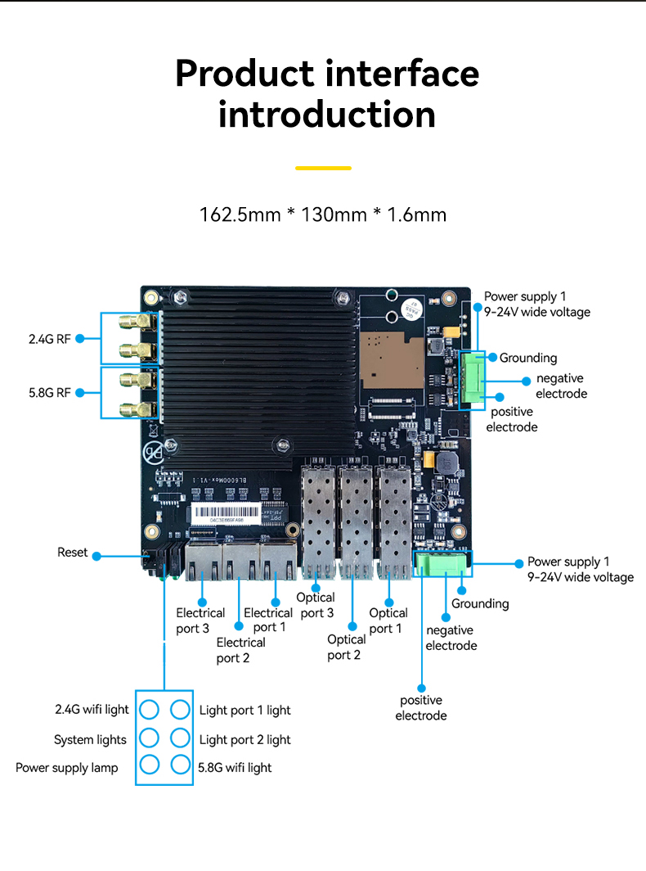
01
Product characteristics
BL6000MAX – three optical and three electric intrinsically safe wifi6AP wireless communication systems
BL6000MAX is a (802.11ax) standard Wi-Fi 6 mining AP. This product adopts the IPQ6000+QCA8075+QCN5052+QCN5022 solution architecture and can support 2.4GHz (2×2)+5.8GHz (2×2) dual-band to provide services at the same time. The overall rate is up to 1.775Gbps. The product hardware design meets intrinsic safety requirements. , highly reliable power supply multi-level protection and port protection design can ensure that BL6000MAX wireless products can work in harsh industrial control environments for a long time.
In terms of application, BL6000MAX has superior wireless coverage performance and strong anti-interference. It also supports millisecond-level Mesh seamless and fast switching roaming technology and cascading self-organizing network technology. The PTP network can reach 900M within 800 meters, and has high concurrent processing performance of up to 200. It provides a stable communication environment with low latency, high bandwidth, high concurrency and fast roaming for underground wireless communication in coal mines, and is widely used in underground wireless communication systems.
www.sailskywifi.com

Slide 5
01
Product characteristics
BL6000Max supports omnidirectional/directional antennas, supports dual radio frequency 2.4GHz+5GHz working simultaneously, supports 3×Gigabit GE electrical ports (WAN/LAN self-identification), 3×Gigabit GE optical ports, and can optionally expand 5G Internet;
Supports 6KV overvoltage protection of the Ethernet interface and operates in a wide temperature range of
-40℃~+75℃, fully meeting the requirements of industrial-grade use;
The external antenna port supports 5KV antenna feed and lightning protection;
The whole machine is designed with low power consumption, the full load power consumption of WIFI single machine is ≤12W, and the full load power consumption of extended 5G Internet is ≤16W;
2. Main features
Wi-Fi 6 (802.11ax) standard
802.11ax is the latest generation Wi-Fi standard of IEEE802.11, which can improve user access capacity and bandwidth in high-density access scenarios, reduce business delays, and enhance wireless transmission experience;
Supports 2.4GHz+5GHz dual-band MU-MIMO, allowing the AP to send data to multiple terminals at the same time, doubling the utilization rate of wireless spectrum resources;
Supports 1024QAM modulation, and the data transmission efficiency is 25% higher than 802.11ac;
Support OFDMA technology, using different subcarriers to transmit data to multiple terminals at the same time, reducing delays and improving network efficiency;
Support spatial multiplexing technology to reduce co-channel interference;
Supports target wake-up time mechanism, allowing AP and terminals to negotiate wake-up time to save energy consumption and conflicts;Mesh flexible networking, fast and seamless roaming switching
It adopts advanced Mesh self-organizing network technology to ensure that the network will not be dropped after the device goes offline within the effective antenna coverage. It also supports wireless ring network and hybrid networking. It fully supports 802.11kvr routing node roaming switching technology, and millisecond-level high-speed switching accelerates the rapid deployment of wireless networks and rapid channel switching selection, providing effective support for wireless mobile communication solutions.
AP+AC flexible management AP intelligent alarm
The product supports flexible management, supports large-scale AC, cross-layer three, and cross-LAN management. Large-scale AC can manage 500-5000 mining APs at the same time.
www.sailskywifi.com

Slide 6
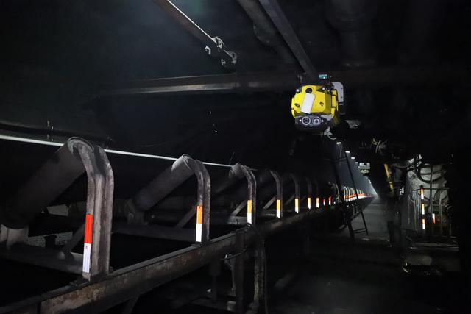
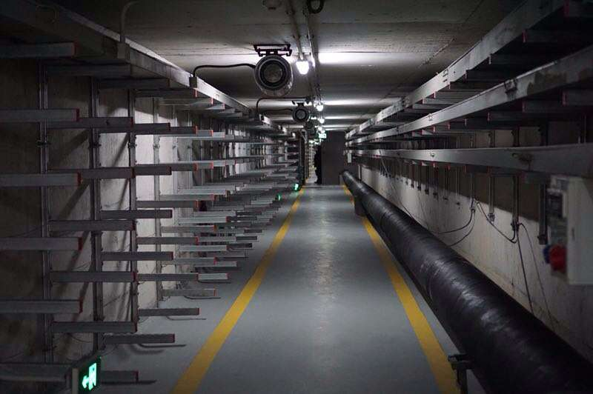
02
Application scenarios
1. Smart mine
2.Smart corridor
www.sailskywifi.com

Slide 7
3 .Offshore wind power
4. Smart mine pit
www.sailskywifi.com

Slide 8
03
Hardware Configuration
Hardware Configuration
Model | BL6000MAX
Chipset | IPQ6000+QCA8075+QCN5052+QCN5022
DDR3 SDRAM | 512M
Flash | spi-flash 16M +nand flash 128M
Size With housing | 128x93x35mm
Bare board size | 170mm * 131mm * 16mm
Unit Weight | 0.2kg(Board)
Operating mode | AP/Mesh/Router (KVR roaming protocol , Seamless roaming switching times ≤50ms)
Reset button | reset button（Press and hold for 10 seconds to restore the factory default configuration）
Status Indicator | Power supply light, system light, wifi light*2, network port light, optical port light
SMA Antennas | 4 SMA antenna interfaces, which can be connected to directional and omnidirectional antennas
Power Consumption | <23W
Power supply | 2 channels of 9-24V 1.5A Phoenix terminal power supply (one channel supplies power to the entire system, and the other channel supplies power to FEM and M.2 sockets)
Interface | 1*Gigabit WAN, 2*Gigabit LAN, 3*Gigabit SFP port, 1*RS485 communication interface
www.sailskywifi.com

Slide 9
04
Wlan Specification
WLAN Standard ±2 dB | 2.4GHz | 5GHz
11 b (1Mbps) | 24 | -
11 b (11Mbps) | 24 | -
11 g (6Mbps) | 24 | -
11 g (54Mbps) | 22 | -
11 a (6Mbps) | - | 24
11 a (54Mbps) | - | 21
HT20(MSC 0/8) | 24 | 24
HT20(MSC 7/15) | 22 | 21
HT40(MSC 0/8) | 24 | 24
HT40(MSC 7/15) | 21 | 21
VHT80 256QAM MCS0 |  | 23
VHT80 256QAM MCS9 |  | 19
VHT80 1024QAM MCS0 |  | 22
VHT80 1024QAM MCS11 |  | 18
www.sailskywifi.com

Slide 10
05
Receive sensitivity
Receive sensitivity (per chain) ±2 dB
 | 2.4GHz | 5GHz
11 g (6Mbps) | -94 | -
11 g (54Mbps) | -78 | -
11 a (6Mbps) | - | -93
11 a (54Mbps) | - | -77
HT20(MSC 0/8) | -92 | -91
HT20(MSC 7/15) | -75 | -74
HT40(MSC 0/8) | -89 | -88
HT40(MSC 7/15) | -72 | -70
VHT20 256QAM @ 3/4 Code Rate | - | -90
VHT20 256QAM @ 5/6 Code Rate | - | -71
VHT40 256QAM @ 3/4 Code Rate | - | -88
VHT40 256QAM @ 5/6 Code Rate | - | -66
VHT80 256QAM @ 3/4 Code Rate | - | -86
VHT80 256QAM @ 5/6 Code Rate | - | -61
VHT80 1024QAM MCS11 | - | -51
www.sailskywifi.com

Slide 11
06
RF characteristics
RF characteristics
RF characteristics | 2.4GHz radio frequency indicators Transmit power: 802.11b: 24dBm±2dBm, 802.11g: 21dBm±2dBm, 802.11n: 20dBm±2dBm; 802.11 ax: 19dBm±2dBm 5GHz radio frequency indicators Transmit power: Low rate: 22dBm±2dBm, 802.11a: 20dBm±2dBm, 802.11n: 18dBm±2dBm, 802.11ac: 17dBm±2dBm; 802.11ax: 16dBm±2dBm
 | Emission rate EVM 11Mbps (11b) ≤0.35 54Mbps ≤-25 (dBm) MCS7 ≤-28 (dBm) ac ≤-32 (dBm) ax ≤-34 (dBm)
 | Receive sensitivity： 802.11b: -86dBm@8% PER， 802.11a/g: -72dBm@10% PER， 802.11n: -69dBm@10% PER， 802.11ac: -55dBm@10% PER 802.11ax: -52dBm@10% PER
www.sailskywifi.com

Slide 12
07
Software features
Software features
Working frequency | 2.4GHz,5.8GHz
Transfer Protocol | Support 2.4G:802.11b/g/n , 5.8GHz：802.11a/n/ac/ax MIMO
Transfer Rate | 1800mbps
Modulation mode | Support 50ms fast switching
VLAN | Support VLAN classification based on access SSID
Mesh protocol | Easy mesh
Systems
Systems status | current connection status |  | Ap mode, wireless channel/frequency, layer 2 user isolation, multiple SSID settings
User list |  | Shows users on the current connection, only authenticated users who are connected
Network configuration |  | Can modify the Internet access method and automatically obtain/static IP
List of Wireless Features
KVR |  | Support 802.11k, 802.11v, 802.11r protocol intelligent fast roaming, switching time ≤ 50ms
802.11mode chose |  | 802.11b/g/n 802.11ac/ax
Channel settings |  | Manual/Auto (Automatically select the best channel)
Transfer rate setting |  | Manual/Auto
Output power control |  | User-defined output power (unit: dBm)
Power saving mode |  | Controllable wireless power saving mode
Multiple SSID support (multiple APs) |  | Support 2.4G 4 SSID Support 5.8G 4 SSID Set up WIFI and security settings separately for each SSID
www.sailskywifi.com

Slide 13
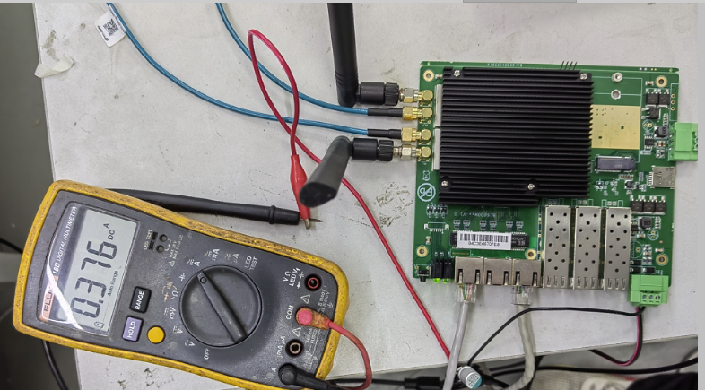
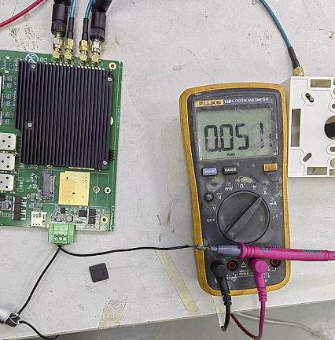
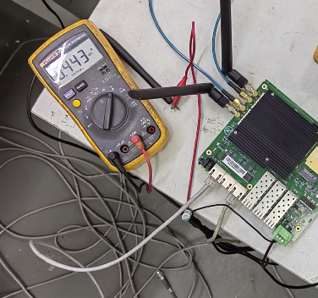
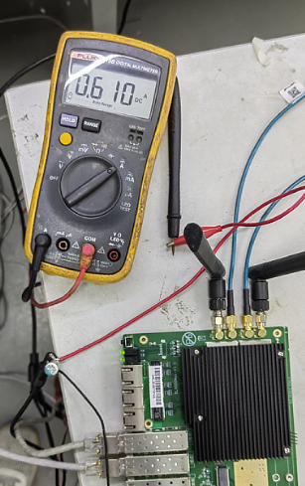
08
Machine power consumption
Machine power consumption
Starting process current Use a multimeter 5.12W
DC-SYS 12V-0.376A 4.512W
DC-FEM-M.2 12V-51Ma 0.612W
Dual-frequency simultaneous transmission throughput 12.63W
DC-SYS 12V-0.443A 5.316W
DC-FEM-M.2 12V-0.610A 7.32W
www.sailskywifi.com

Slide 14
09
LED
LED
6 indicators indicating the operating status of the product (can be configured through GPIO)
10
Physical properties
Physical properties
Working environment | Working temperature: -40°C～70°C
 | Storage temperature: -50°C～80°C
 | Humidity: 5%～95% (non-condensing)
11
Environmental indicators
Environmental indicators
Altitude | -1000m~5000m
Working pressure | 53kPa~105kPa
Power consumption | WIFI stand-alone full load power consumption ≤ 12W, extended 5G Internet full load power consumption ≤ 16W
www.sailskywifi.com

Slide 15
Welcome to visit us for more info or quotation:
SHENZHEN SHUOTIAN INFORMATION TECHNOLOGY CO.,LTD
2/F, Building E, Huasai Industrial Zone, Bantian Street,Longgang District, Shenzhen,Guangdong Province, ChinaChinaWeb：www.sskycn.com
E-mail：Natalie@sskycn.com
Tel/WhatsAPP/Wechat: +86-13760857118
Copyright©2020 shenzhen shuotian information technology CO.,LTD，all rights reserved

