Slide 1


Datasheet
BL series
BL70HWHW
File version: V1.0
Copyright©2020 SHENZHEN SHUOTIAN INFORMATION TECHNOLOGY CO., LTD., all rights reserved

Slide 2


Power and responsibility statement
No content of this publication may be reproduced, disseminated, transcribed, stored in a retrieval system, or translated into any human or computer language, in any form or by any means, without the written permission of the Company. The use of unauthorized copies of products not only infringes copyright but may prevent Shuotian Information Technology from providing accurate and up-to-date information to users and operators.
is the trademark of Shenzhen Shuotian Information Technology Co., Ltd. All other trademarks, product logos and trade names mentioned in this manual are the property of their respective owners.
The content of this manual is subject to change due to product version upgrade or other reasons. Shuotian Information Technology Co., Ltd. reserves the right to modify the content of this manual without any notice or prompt. In laws and regulations allow range, day to recognize Shuotian information technology co., LTD., in any case, all wrong because of the use of this product manual or this website content and cause of the accident, negligence, contract damage, defamation, copyright or intellectual property infringement and any special, incidental, indirect, secondary loss compensation, no any profits, data, and to compensate the loss of goodwill or anticipated savings, also does not assume any legal liability.
Security statement
Please read the safety and compatibility information of the product before powering it up.
Environmental statement
The product conforms to the design requirements of environmental protection. The storage, use and disposal of the product shall comply with the requirements of relevant national laws and regulations.
Revision record
The revision record accumulates the notes for each manual update, and the latest version of the manual contains all previous manual updates.
www.sailskywifi.com

Slide 3
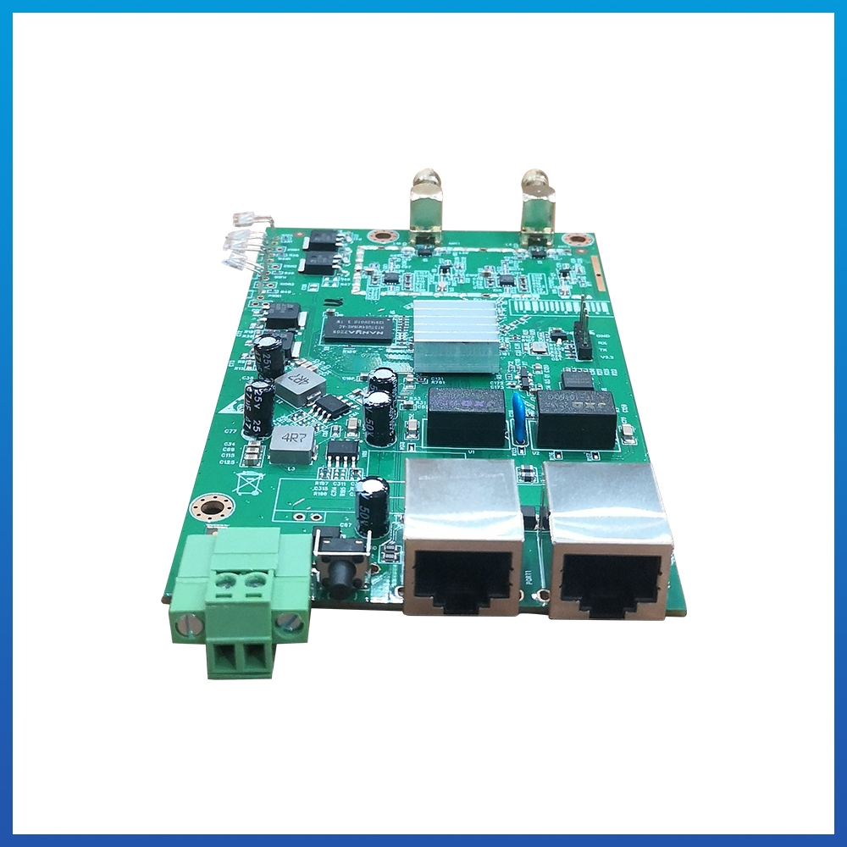
www.sailskywifi.com
BL70HWHW
Outdoor Access Point
2.4GHz 300Mbps
Product introduction:
BL70HW is a new generation of high-performance, cost-effective and intrinsically safe wireless product that works in the 2.4G frequency band and supports 802.11b/g MIMO technology. It adopts Qualcomm QCA9531 solution, 16M flash memory/128M memory, 100M network interface, 2.4G 802.11n MIMO technology wireless processing speed up to 300Mbps, which can meet the needs of 64 people for wireless high-speed Internet access at the same time. The hardware design meets intrinsic safety requirements, and the highly reliable multi-level power supply protection and port protection design ensure that the BL70HW wireless product can work in harsh industrial control environments for a long time.
Ultra-miniature design concept, terminal interface, stable and shock-resistant, can be built into robots, cameras, handheld remote controls, explosion-proof boxes, AGV and other equipment.
It can be widely used in industrial applications, mining intrinsic safety, mobile robot inspection, high-bandwidth communications and other industry applications.
Easily adapt to extreme outdoor environments of high temperature and cold. It can be equipped with an external directional antenna, supports pole/wall-mounted installation, and supports terminal power supply. It is flexible and plug-and-play. It has the characteristics of high gain, high receiving sensitivity, high bandwidth, high number of accesses, etc., and has a wide range of wireless coverage. , stable performance, suitable for wireless transmission scenarios such as mines, pipe corridors, etc.
SHENZHEN SHUOTIAN INFORMATION & TECHNOLOGY CO., LTD

Slide 4
www.sailskywifi.com
Hardware
Model | BL70HW
Chipset | Qualcomm QCA9531 300Mbps
CPU Clock Speed | 550MHz
Standards | 2.4G:300M 802.11b/g/n MIMO Technology
Memory | 128MB DDR2 RAM
Flash | 16MB
Interface | 1 * 10/100Mbps WAN 1 * 10/100Mbps LAN(POE) 1*Reset Button 1 *DC Phoenix terminal
Indicator light | W/LAN light,LAN light,System light,Power supply light,
Button | 1*Reset Button， Long press to reset, short press to adjust digital display number
Power Consumption | <9W
Power Supply | Phoenix terminal 9v-24V
Weight | 0.7KG
Toggle switch | Define product AP Mode and Repeater Mode
Antenna | 2*SMA antenna interfaces
Environment Temperature
Operating temperature | Temperature: -40℃～+55℃ (working), -40℃～+70℃ (storage) Humidity (non-condensing): 5% ~ 90% (working), 5% ~ 95% (storage)
SHENZHEN SHUOTIAN INFORMATION & TECHNOLOGY CO., LTD

Slide 5
www.sailskywifi.com
Radio frequency Feature
Frequency Range | ISM band: 2.400 ~ 2.4835 GHz
Channel | 2G:1、2、3、4、5、6、7、8、9、10、11、12、13
Modulation method | OFDM = BPSK, QPSK,16-QAM,64-QAM; DSSS = DBPSK, DQPSK, CCK
Output power | 2.4G: 11n @MCS0~2/MCS8~10:27±1dBm @MCS7/MCS15:23±1dBm 11g @6~24M:27±1dBm @54M:23±1dBm 11b @1~11M:27±1dBm
Receiving sensitivity | 2.4G: 11n: -86dbm@MCS0 -68dbm@MCS7 -86dbm@MCS8 -64dbm@MCS15 11g: -90dbm@6Mbps -68dbm@54Mbps 11b: -90dbm@1Mbps -85dBm@11Mbps
EVM | 802.11n: ≤-29 dB 802.11g: ≤-26 dB802.11b:
Frequency offset | ±20ppm
Software Feature
Working Mode | Router,AP and Repeater
Seamless roaming | Support KVR fast switching without perception
VLAN | Support VLAN classification based on access SSID
AC Management | Support AC cross-layer three switch management
Users | 64
System | Restore factory/system restart
SHENZHEN SHUOTIAN INFORMATION & TECHNOLOGY CO., LTD

Slide 6

Welcome to visit us for more info or quotation:
SHENZHEN SHUOTIAN INFORMATION TECHNOLOGY CO.,LTD
5/F,Shenzhou Building,Bantian Street, Longgang District, Shenzhen,Guangdong Province,
ChinaWeb：www.sailskywifi.com
E-mail：natalie@sskycn.com
Tel/WhatsAPP/Wechat: +86-13760857118
Copyright©2020 Shuotian Information Technology Co., Ltd., all rights reserved

